Slide 1


CSB4403 – Applied Cryptography and Network Security
B.Tech – VII Semester
Dr. S.Sathya Priya
Associate professor
School of Computing Sciences,
Department of Computer Science and Engineering

Slide 2
MODULE 4: KEY MANAGEMENT & DISTRIBUTION
Symmetric Key Distribution Using Symmetric Encryption -Symmetric Key Distribution Using Assymmetric Encryption- Distribution of Public Keys-Public Announcement of Public Keys -Publicly Available Directory - Public-Key Authority- Public-Key Certificates- Remote User-Authentication Principles- Remote User-Authentication Using Symmetric Encryption- Kerberos- Remote User Authentication Using Asymmetric Encryption

Slide 3
Key Distribution Technique
Term that refers to the means of delivering a key to two parties who wish to exchange data without allowing others to see the key
For symmetric encryption to work, the two parties to an exchange must share the same key, and that key must be protected from access by others
Frequent key changes are desirable to limit the amount of data compromised if an attacker learns the key
Notes:
For symmetric encryption to work, the two parties to an exchange must share the
same key, and that key must be protected from access by others. Furthermore, frequent
key changes are usually desirable to limit the amount of data compromised if
an attacker learns the key. Therefore, the strength of any cryptographic system rests
with the key distribution technique , a term that refers to the means of delivering a
key to two parties who wish to exchange data without allowing others to see the key.

Slide 4
Symmetric Key Distribution
Given parties A and B, key distribution can be achieved in a number of ways:
A can select a key and physically deliver it to B
A third party can select the key and physically deliver it to A and B
If A and B have previously and recently used a key, one party can transmit the new key to the other, encrypted using the old key
If A and B each has an encrypted connection to a third party C, C can deliver a key on the encrypted links to A and B
Notes:
For two parties A and B, key distribution can be achieved in a number of ways, as
follows:
1. A can select a key and physically deliver it to B.
2. A third party can select the key and physically deliver it to A and B.
3. If A and B have previously and recently used a key, one party can transmit the
new key to the other, encrypted using the old key.
4. If A and B each has an encrypted connection to a third party C, C can deliver
a key on the encrypted links to A and B.
Options 1 and 2 call for manual delivery of a key. For link encryption, this
is a reasonable requirement, because each link encryption device is going to be
exchanging data only with its partner on the other end of the link. However, for
end-to-end encryption over a network, manual delivery is awkward. In a distributed
system, any given host or terminal may need to engage in exchanges with
many other hosts and terminals over time. Thus, each device needs a number of
keys supplied dynamically. The problem is especially difficult in a wide-area distributed
system.

Slide 5
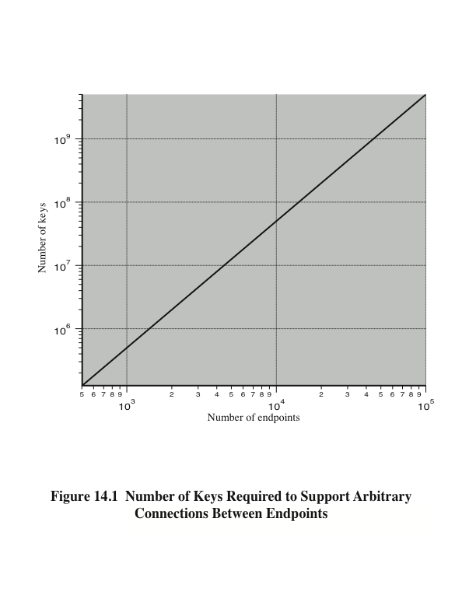
Notes:
The scale of the problem depends on the number of communicating pairs that must be supported. If end-to-end encryption is done at a network or IP level, then a key is needed for each pair of hosts on the network that wish to communicate. Thus, if there are N hosts, the number of required keys is [N(N – 1)]/2. If encryption is done at the application level, then a key is needed for every pair of users or processes that require communication. Thus, a network may have hundreds of hosts but thousands of users and processes. Figure 14.1 illustrates the magnitude of the key distribution task for end-to-end encryption. A network using node-level encryption with 1000 nodes would conceivably need to distribute as many as half a million keys. If that same network supported 10,000 applications, then as many as 50 million keys may be required for application-level encryption.

Slide 6
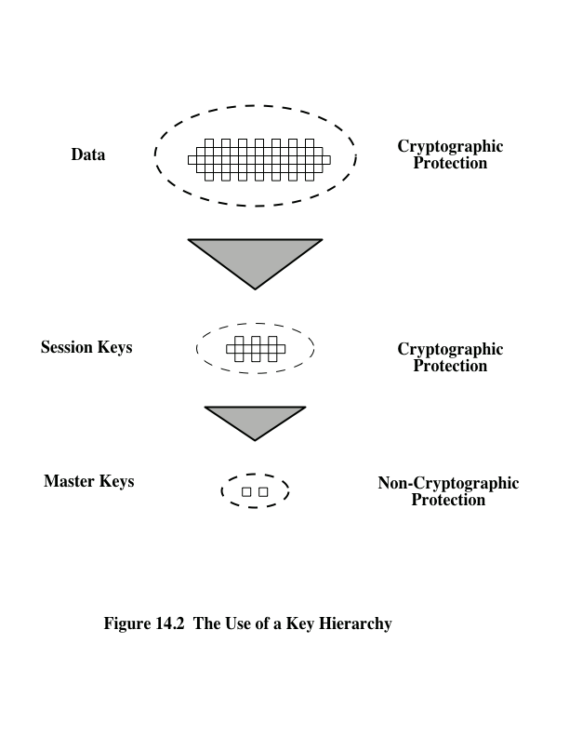
Notes:
For end-to-end encryption, some variation on option 4 has been widely
adopted. In this scheme, a key distribution center is responsible for distributing
keys to pairs of users (hosts, processes, applications) as needed. Each user must
share a unique key with the key distribution center for purposes of key distribution.
The use of a key distribution center is based on the use of a hierarchy of keys.
At a minimum, two levels of keys are used (Figure 14.2). Communication between
end systems is encrypted using a temporary key, often referred to as a session key .
Typically, the session key is used for the duration of a logical connection, such as a
frame relay connection or transport connection, and then discarded. Each session
key is obtained from the key distribution center over the same networking facilities
used for end-user communication. Accordingly, session keys are transmitted in
encrypted form, using a master key that is shared by the key distribution center and
an end system or user.
For each end system or user, there is a unique master key that it shares with
the key distribution center. Of course, these master keys must be distributed in some
fashion. However, the scale of the problem is vastly reduced. If there are N entities
that wish to communicate in pairs, then, as was mentioned, as many as [N (N - 1)]/2
session keys are needed at any one time. However, only N master keys are required,
one for each entity. Thus, master keys can be distributed in some non-cryptographic
way, such as physical delivery.

Slide 7
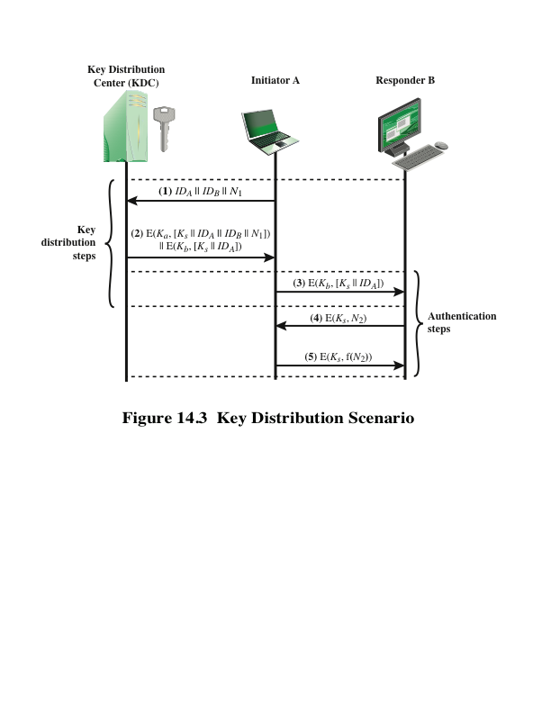
Notes:
The key distribution concept can be deployed in a number of ways. A typical
scenario is illustrated in Figure 14.3, which is based on a figure in [POPE79]. The
scenario assumes that each user shares a unique master key with the key distribution
center (KDC).

Slide 8
Hierarchical Key Control
For communication among entities within the same local domain, the local KDC is responsible for key distribution
If two entities in different domains desire a shared key, then the corresponding local KDC’s can communicate through a global KDC
The hierarchical concept can be extended to three or more layers
Scheme minimizes the effort involved in master key distribution because most master keys are those shared by a local KDC with its local entities
Limits the range of a faulty or subverted KDC to its local area only
Notes:
It is not necessary to limit the key distribution function to a single KDC. Indeed, for
very large networks, it may not be practical to do so. As an alternative, a hierarchy
of KDCs can be established. For example, there can be local KDCs, each responsible
for a small domain of the overall internetwork, such as a single LAN or a single
building. For communication among entities within the same local domain, the local
KDC is responsible for key distribution. If two entities in different domains desire a
shared key, then the corresponding local KDCs can communicate through a global
KDC. In this case, any one of the three KDCs involved can actually select the key.
The hierarchical concept can be extended to three or even more layers, depending
on the size of the user population and the geographic scope of the internetwork.
A hierarchical scheme minimizes the effort involved in master key distribution,
because most master keys are those shared by a local KDC with its local entities.
Furthermore, such a scheme limits the damage of a faulty or subverted KDC to
its local area only.

Slide 9
Session Key Lifetime
A security manager must balance competing considerations:
The more frequently session keys are exchanged, the more secure they are
The distribution of session keys delays the start of any exchange and places a burden on network capacity
For connection-oriented protocols one choice is to use the same session key for the length of time that the connection is open, using a new session key for each new session
For a connectionless protocol there is no explicit connection initiation or termination, thus it is not obvious how often one needs to change the session key
Notes:
The more frequently session keys are exchanged, the more secure they are, because
the opponent has less ciphertext to work with for any given session key. On the
other hand, the distribution of session keys delays the start of any exchange and
places a burden on network capacity. A security manager must try to balance these
competing considerations in determining the lifetime of a particular session key.
For connection-oriented protocols, one obvious choice is to use the same session
key for the length of time that the connection is open, using a new session key
for each new session. If a logical connection has a very long lifetime, then it would
be prudent to change the session key periodically, perhaps every time the PDU
(protocol data unit) sequence number cycles.
For a connectionless protocol, such as a transaction-oriented protocol, there
is no explicit connection initiation or termination. Thus, it is not obvious how often
one needs to change the session key. The most secure approach is to use a new session
key for each exchange. However, this negates one of the principal benefits of
connectionless protocols, which is minimum overhead and delay for each transaction.
A better strategy is to use a given session key for a certain fixed period only or
for a certain number of transactions.

Slide 10
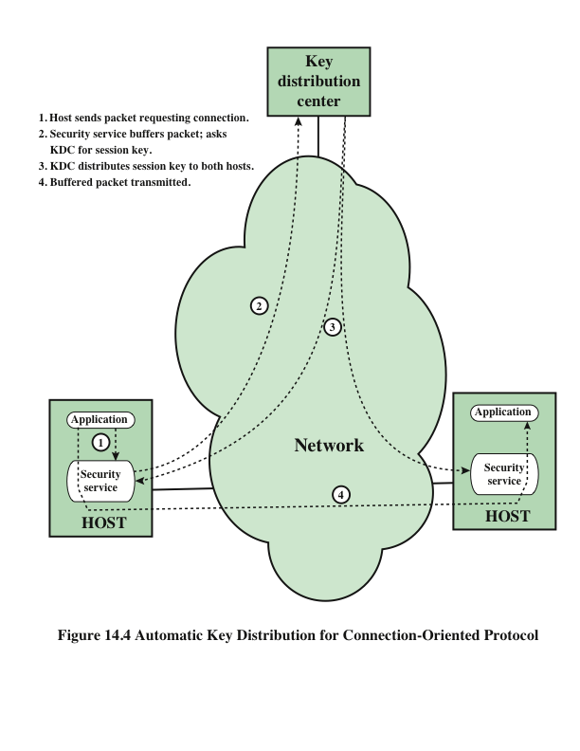
Notes:
The approach suggested in Figure 14.3 has many variations, one of which is
described in this subsection. The scheme (Figure 14.4) is useful for providing end-to-
end encryption at a network or transport level in a way that is transparent to
the end users. The approach assumes that communication makes use of a connection-
oriented end-to-end protocol, such as TCP. The noteworthy element of this
approach is a session security module (SSM), which may consist of functionality at
one protocol layer, that performs end-to-end encryption and obtains session keys
on behalf of its host or terminal.
The steps involved in establishing a connection are shown in Figure 14.4. When
one host wishes to set up a connection to another host, it transmits a connection-request
packet (step 1). The SSM saves that packet and applies to the KDC for permission
to establish the connection (step 2). The communication between the SSM and
the KDC is encrypted using a master key shared only by this SSM and the KDC. If the
KDC approves the connection request, it generates the session key and delivers it to
the two appropriate SSMs, using a unique permanent key for each SSM (step 3). The
requesting SSM can now release the connection request packet, and a connection is
set up between the two end systems (step 4). All user data exchanged between the two
end systems are encrypted by their respective SSMs using the one-time session key.
The automated key distribution approach provides the flexibility and dynamic
characteristics needed to allow a number of terminal users to access a number of
hosts and for the hosts to exchange data with each other.

Slide 11
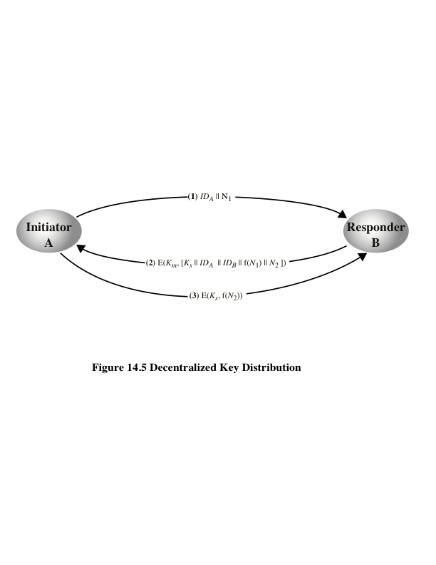
Notes:
The use of a key distribution center imposes the requirement that the KDC be trusted
and be protected from subversion. This requirement can be avoided if key distribution
is fully decentralized. Although full decentralization is not practical for larger
networks using symmetric encryption only, it may be useful within a local context.
A decentralized approach requires that each end system be able to communicate
in a secure manner with all potential partner end systems for purposes of
session key distribution. Thus, there may need to be as many as [n (n - 1)]/2 master
keys for a configuration with n end systems.
A session key may be established with the following sequence of steps
(Figure 14.5).
1. A issues a request to B for a session key and includes a nonce, N₁.
2. B responds with a message that is encrypted using the shared master key. The
response includes the session key selected by B, an identifier of B, the value
f(N₁), and another nonce, N₂.
3. Using the new session key, A returns f(N₂) to B.
Thus, although each node must maintain at most (n - 1) master keys, as many
session keys as required may be generated and used. Because the messages transferred
using the master key are short, cryptanalysis is difficult. As before, session
keys are used for only a limited time to protect them.

Slide 12
Controlling Key Usage
The concept of a key hierarchy and the use of automated key distribution techniques greatly reduce the number of keys that must be manually managed and distributed
It also may be desirable to impose some control on the way in which automatically distributed keys are used
For example, in addition to separating master keys from session keys, we may wish to define different types of session keys on the basis of use
Notes:
The concept of a key hierarchy and the use of automated key distribution techniques
greatly reduce the number of keys that must be manually managed and distributed.
It also may be desirable to impose some control on the way in which automatically
distributed keys are used. For example, in addition to separating master keys from
session keys, we may wish to define different types of session keys on the basis of
use, such as
• Data-encrypting key, for general communication across a network
• PIN-encrypting key, for personal identification numbers (PINs) used in electronic
funds transfer and point-of-sale applications
• File-encrypting key, for encrypting files stored in publicly accessible locations
To illustrate the value of separating keys by type, consider the risk that a master
key is imported as a data-encrypting key into a device. Normally, the master key
is physically secured within the cryptographic hardware of the key distribution center
and of the end systems. Session keys encrypted with this master key are available
to application programs, as are the data encrypted with such session keys. However,
if a master key is treated as a session key, it may be possible for an unauthorized
application to obtain plaintext of session keys encrypted with that master key.

Slide 13
Key Controls
Associate a tag with each key
For use with DES and makes use of the extra 8 bits in each 64-bit DES key
The eight non-key bits ordinarily reserved for parity checking form the key tag
Because the tag is embedded in the key, it is encrypted along with the key when that key is distributed, thus providing protection
Drawbacks:
The tag length is limited to 8 bits, limiting its flexibility and functionality
Because the tag is not transmitted in clear form, it can be used only at the point of decryption, limiting the ways in which key use can be controlled
Notes:
Thus, it may be desirable to institute controls in systems that limit the ways
in which keys are used, based on characteristics associated with those keys. One
simple plan is to associate a tag with each key ([JONE82]; see also [DAVI89]). The
proposed technique is for use with DES and makes use of the extra 8 bits in each
64-bit DES key. That is, the eight non-key bits ordinarily reserved for parity checking
form the key tag. The bits have the following interpretation:
• One bit indicates whether the key is a session key or a master key.
• One bit indicates whether the key can be used for encryption.
• One bit indicates whether the key can be used for decryption.
• The remaining bits are spares for future use.
Because the tag is embedded in the key, it is encrypted along with the key when that
key is distributed, thus providing protection. The drawbacks of this scheme are
1. The tag length is limited to 8 bits, limiting its flexibility and functionality.
2. Because the tag is not transmitted in clear form, it can be used only at the
point of decryption, limiting the ways in which key use can be controlled.

Slide 14
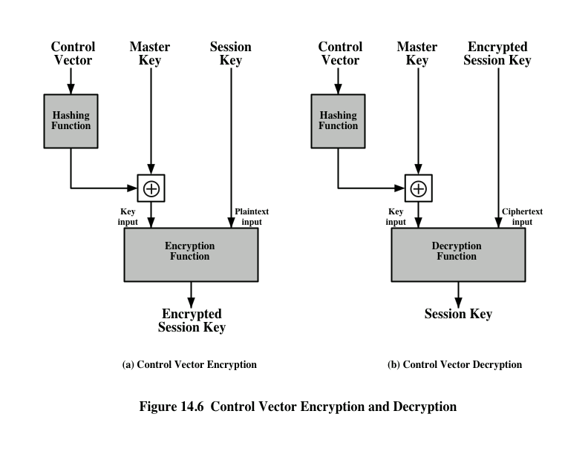
Notes:
A more flexible scheme, referred to as the control vector, is described in
[MATY91a and b]. In this scheme, each session key has an associated control vector
consisting of a number of fields that specify the uses and restrictions for that session
key. The length of the control vector may vary.
The control vector is cryptographically coupled with the key at the time of
key generation at the KDC. The coupling and decoupling processes are illustrated
in Figure 14.6. As a first step, the control vector is passed through a hash function
that produces a value whose length is equal to the encryption key length. Hash
functions are discussed in detail in Chapter 11. In essence, a hash function maps
values from a larger range into a smaller range with a reasonably uniform spread.
Thus, for example, if numbers in the range 1 to 100 are hashed into numbers in the
range 1 to 10, approximately 10% of the source values should map into each of the
target values.
When a session key is delivered to a user from the KDC, it is accompanied by
the control vector in clear form. The session key can be recovered only by using both
the master key that the user shares with the KDC and the control vector. Thus, the
linkage between the session key and its control vector is maintained.
Use of the control vector has two advantages over use of an 8-bit tag. First, there
is no restriction on length of the control vector, which enables arbitrarily complex controls
to be imposed on key use. Second, the control vector is available in clear form at
all stages of operation. Thus, control of key use can be exercised in multiple locations.

Slide 15
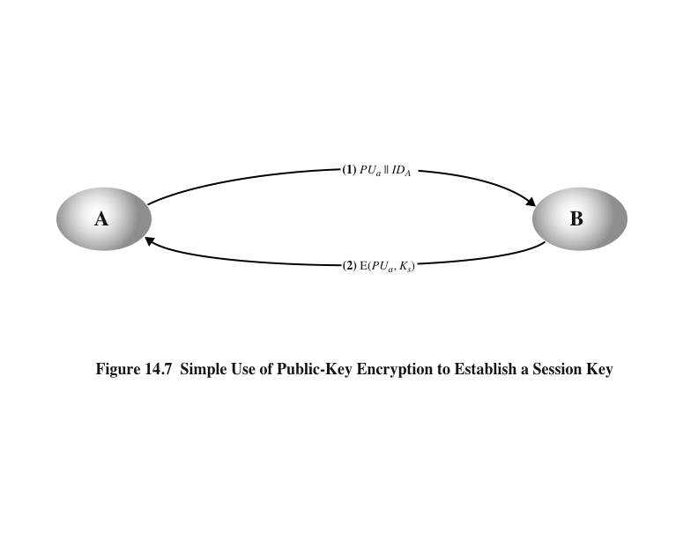
Simple Secret Key Distribution
Notes:
An extremely simple scheme was put forward by Merkle [MERK79], as illustrated in
Figure 14.7.
Despite its simplicity, this is an attractive protocol. No keys exist before the start of
the communication and none exist after the completion of communication. Thus,
the risk of compromise of the keys is minimal. At the same time, the communication
is secure from eavesdropping.

Slide 16
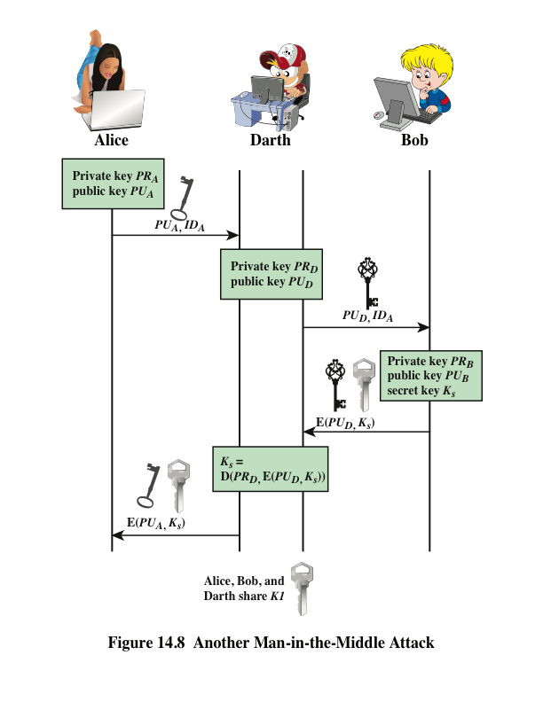
Man-in-the-Middle Attack
Notes:
The protocol depicted in Figure 14.7 is insecure against an adversary who
can intercept messages and then either relay the intercepted message or substitute
another message (see Figure 1.3c). Such an attack is known as a man-in-the-middle
attack [RIVE84]. We saw this type of attack in Chapter 10 (Figure 10.2). In the
present case, if an adversary, D, has control of the intervening communication channel,
then D can compromise the communication in the following fashion without
being detected (Figure 14.8).
Thus, this simple protocol is only useful in an environment where the only threat is eavesdropping.

Slide 17
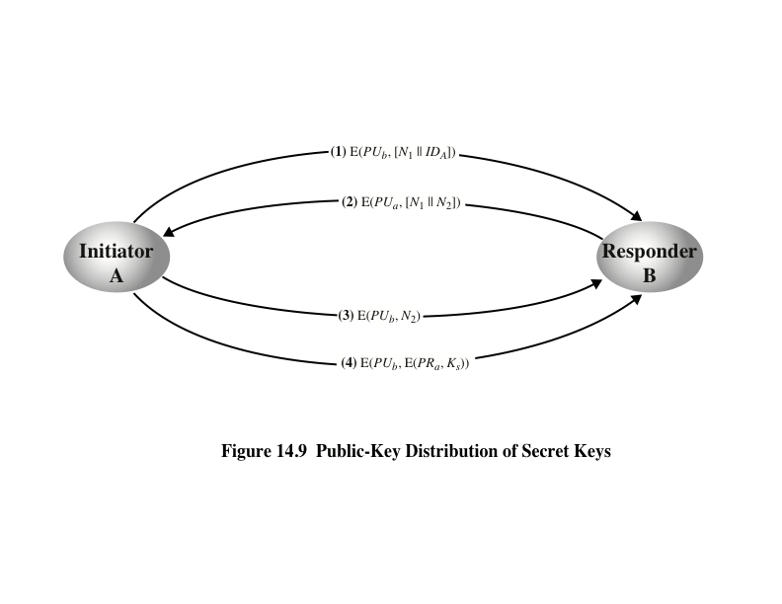
Secret Key Distribution with Confidentiality and Authentication
Notes:
Figure 14.9, based on an approach suggested in [NEED78], provides protection
against both active and passive attacks.
The result is that this scheme ensures both confidentiality and authentication
in the exchange of a secret key.

Slide 18
A Hybrid Scheme
In use on IBM mainframes
Retains the use of a key distribution center (KDC) that shares a secret master key with each user and distributes secret session keys encrypted with the master key
A public-key scheme is used to distribute the master keys
Rationale:
Performance
Backward compatibility
Notes:
Yet another way to use public-key encryption to distribute secret keys is a hybrid
approach in use on IBM mainframes [LE93]. This scheme retains the use of a key
distribution center (KDC) that shares a secret master key with each user and distributes
secret session keys encrypted with the master key. A public-key scheme is
used to distribute the master keys. The following rationale is provided for using this
three-level approach:
• Performance: There are many applications, especially transaction-oriented
applications, in which the session keys change frequently. Distribution of session
keys by public-key encryption could degrade overall system performance
because of the relatively high computational load of public-key encryption
and decryption. With a three-level hierarchy, public-key encryption is used
only occasionally to update the master key between a user and the KDC.
• Backward compatibility: The hybrid scheme is easily overlaid on an existing
KDC scheme with minimal disruption or software changes.
The addition of a public-key layer provides a secure, efficient means of distributing
master keys. This is an advantage in a configuration in which a single KDC
serves a widely distributed set of users.

Slide 19
Distribution of Public Keys
Several techniques have been proposed for the distribution of public keys. Virtually all these proposals can be grouped into the following general schemes:
Public announcement
Publicly available directory
Public-key authority
Public-key certificates
Notes:
Several techniques have been proposed for the distribution of public keys, which can mostly be grouped into the categories shown.

Slide 20
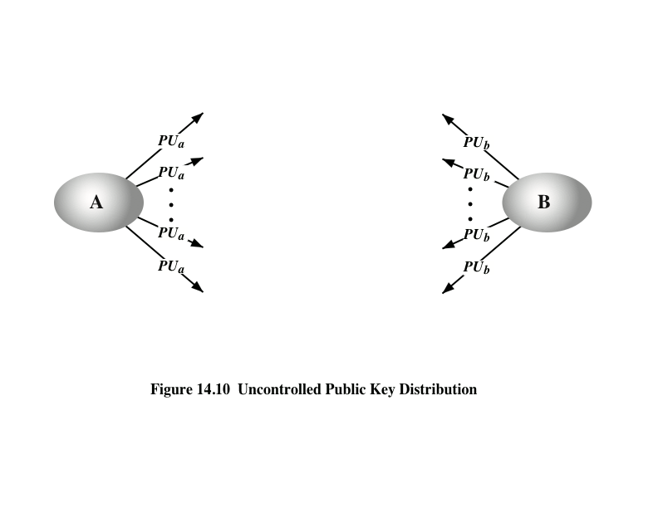
Public Announcement
Notes:
On the face of it, the point of public-key encryption is that the public key is public.
Thus, if there is some broadly accepted public-key algorithm, such as RSA, any participant
can send his or her public key to any other participant or broadcast the key to the
community at large (Figure 14.10). For example, because of the growing popularity of
PGP (pretty good privacy, discussed in Chapter 19), which makes use of RSA, many
PGP users have adopted the practice of appending their public key to messages that
they send to public forums, such as USENET newsgroups and Internet mailing lists.
Although this approach is convenient, it has a major weakness. Anyone can
forge such a public announcement. That is, some user could pretend to be user A
and send a public key to another participant or broadcast such a public key. Until
such time as user A discovers the forgery and alerts other participants, the forger is
able to read all encrypted messages intended for A and can use the forged keys for
authentication (see Figure 9.3).

Slide 21
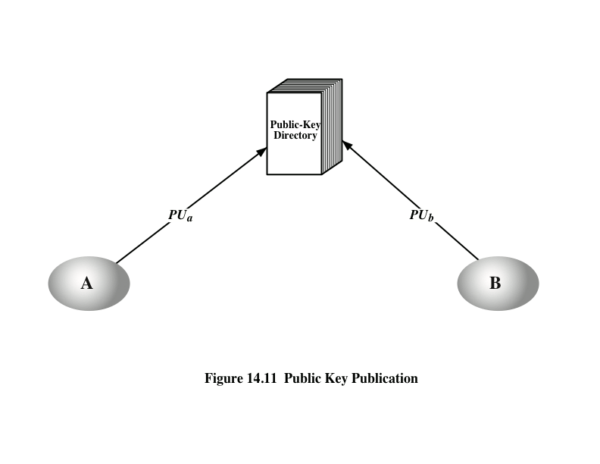
Publicly Available Directory
Notes:
A greater degree of security can be achieved by maintaining a publicly available
dynamic directory of public keys. Maintenance and distribution of the public
directory would have to be the responsibility of some trusted entity or organization
(Figure 14.11). Such a scheme would include the following elements:
1. The authority maintains a directory with a {name, public key} entry for each
participant.
2. Each participant registers a public key with the directory authority.
Registration would have to be in person or by some form of secure authenticated
communication.
3. A participant may replace the existing key with a new one at any time, either
because of the desire to replace a public key that has already been used for a
large amount of data, or because the corresponding private key has been compromised
in some way.
4. Participants could also access the directory electronically. For this purpose,
secure, authenticated communication from the authority to the participant is
mandatory.
This scheme is clearly more secure than individual public announcements
but still has vulnerabilities. If an adversary succeeds in obtaining or computing the
private key of the directory authority, the adversary could authoritatively pass out
counterfeit public keys and subsequently impersonate any participant and eavesdrop
on messages sent to any participant. Another way to achieve the same end is
for the adversary to tamper with the records kept by the authority.

Slide 22
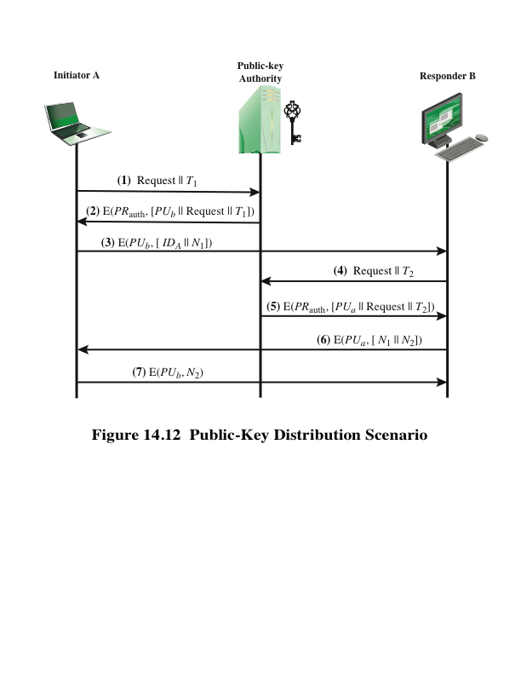
Notes:
Stronger security for public-key distribution can be achieved by providing
tighter control over the distribution of public keys from the directory. A typical
scenario is illustrated in Figure 14.12, which is based on a figure in [POPE79].
As before, the scenario assumes that a central authority maintains a dynamic
directory of public keys of all participants. In addition, each participant reliably
knows a public key for the authority, with only the authority knowing the corresponding
private key.
A total of seven messages are required. However, the initial five messages
need be used only infrequently because both A and B can save the other’s
public key for future use—a technique known as caching. Periodically, a user should
request fresh copies of the public keys of its correspondents to ensure currency.

Slide 23
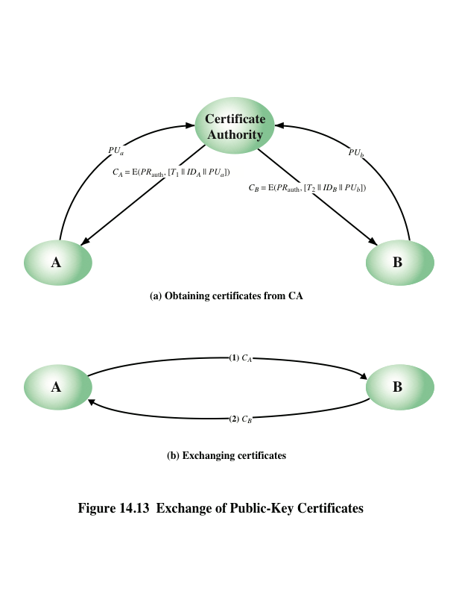
Notes:
The scenario of Figure 14.12 is attractive, yet it has some drawbacks. The public-key
authority could be somewhat of a bottleneck in the system, for a user must appeal
to the authority for a public key for every other user that it wishes to contact. As
before, the directory of names and public keys maintained by the authority is vulnerable
to tampering.
An alternative approach, first suggested by Kohnfelder [KOHN78], is to use
certificates that can be used by participants to exchange keys without contacting a
public-key authority, in a way that is as reliable as if the keys were obtained directly
from a public-key authority. In essence, a certificate consists of a public key, an
identifier of the key owner, and the whole block signed by a trusted third party.
Typically, the third party is a certificate authority, such as a government agency or a
financial institution, that is trusted by the user community. A user can present his or
her public key to the authority in a secure manner and obtain a certificate. The user
can then publish the certificate. Anyone needing this user’s public key can obtain
the certificate and verify that it is valid by way of the attached trusted signature.
A participant can also convey its key information to another by transmitting its
certificate. Other participants can verify that the certificate was created by the
authority. We can place the following requirements on this scheme:
1. Any participant can read a certificate to determine the name and public key of
the certificate’s owner.
2. Any participant can verify that the certificate originated from the certificate
authority and is not counterfeit.
3. Only the certificate authority can create and update certificates.
These requirements are satisfied by the original proposal in [KOHN78]. Denning
[DENN83] added the following additional requirement:
4. Any participant can verify the currency of the certificate.
A certificate scheme is illustrated in Figure 14.13. Each participant applies
to the certificate authority, supplying a public key and requesting a certificate.
Application must be in person or by some form of secure authenticated communication.

Slide 24
Certificates
Version
Serial number
Signature algorithm identifier
Issuer name
Period of validity
Subject name
Subject’s public-key information
Issuer unique identifier
Subject unique identifier
Extensions
Signature
Created by a trusted Certification Authority (CA) and have the following elements:
Notes:
The heart of the X.509 scheme is the public-key certificate associated with each
user. These user certificates are assumed to be created by some trusted certification
authority (CA) and placed in the directory by the CA or by the user. The directory
server itself is not responsible for the creation of public keys or for the certification
function; it merely provides an easily accessible location for users to obtain
certificates.
• Version: Differentiates among successive versions of the certificate format;
the default is version 1. If the issuer unique identifier or subject unique identifier
are present, the value must be version 2. If one or more extensions are
present, the version must be version 3.
• Serial number: An integer value unique within the issuing CA that is unambiguously
associated with this certificate.
• Signature algorithm identifier: The algorithm used to sign the certificate
Together
with any associated parameters. Because this information is repeated
in the signature field at the end of the certificate, this field has little, if any,
utility.
• Issuer name: X.500 name of the CA that created and signed this certificate.
• Period of validity: Consists of two dates: the first and last on which the certificate
is valid.
• Subject name: The name of the user to whom this certificate refers. That is,
this certificate certifies the public key of the subject who holds the corresponding
private key.
• Subject’s public-key information: The public key of the subject, plus an identifier
of the algorithm for which this key is to be used, together with any associated
parameters.
• Issuer unique identifier: An optional-bit string field used to identify uniquely
the issuing CA in the event the X.500 name has been reused for different
entities.
• Subject unique identifier: An optional-bit string field used to identify uniquely
the subject in the event the X.500 name has been reused for different entities.
• Extensions: A set of one or more extension fields. Extensions were added in
version 3 and are discussed later in this section.
• Signature: Covers all of the other fields of the certificate; it contains the
hash code of the other fields encrypted with the CA’s private key. This field
includes the signature algorithm identifier.

Slide 25
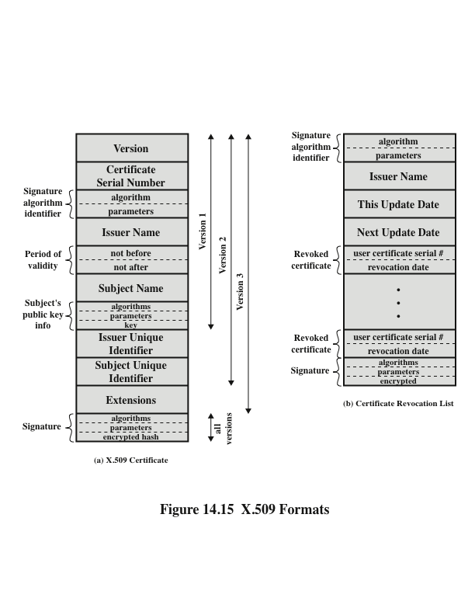
Notes:
Figure 14.15a shows the general format of a certificate.

Slide 26
Obtaining a Certificate
User certificates generated by a CA have the following characteristics:
Any user with access to the public key of the CA can verify the user public key that was certified
No party other than the certification authority can modify the certificate without this being detected
Because certificates are unforgeable, they can be placed in a directory without the need for the directory to make special efforts to protect them
In addition, a user can transmit his or her certificate directly to other users
Once B is in possession of A’s certificate, B has confidence that messages it encrypts with A’s public key will be secure from eavesdropping and that messages signed with A’s private key are unforgeable
Notes:
User certificates generated by a CA have the following
characteristics:
• Any user with access to the public key of the CA can verify the user public key
that was certified.
• No party other than the certification authority can modify the certificate without
this being detected.
Because certificates are unforgeable, they can be placed in a directory without the
need for the directory to make special efforts to protect them.
If all users subscribe to the same CA, then there is a common trust of that CA.
All user certificates can be placed in the directory for access by all users. In addition,
a user can transmit his or her certificate directly to other users. In either case,
once B is in possession of A’s certificate, B has confidence that messages it encrypts
with A’s public key will be secure from eavesdropping and that messages signed
with A’s private key are unforgeable.
If there is a large community of users, it may not be practical for all users to
subscribe to the same CA. Because it is the CA that signs certificates, each participating
user must have a copy of the CA’s own public key to verify signatures. This
public key must be provided to each user in an absolutely secure (with respect to
integrity and authenticity) way so that the user has confidence in the associated certificates.
Thus, with many users, it may be more practical for there to be a number
of CAs, each of which securely provides its public key to some fraction of the users.

Slide 27
Remote User-Authentication Principles
The process of verifying an identity claimed by or for a system entity
An authentication process consists of two steps:
Identification step
Presenting an identifier to the security system
Verification step
Presenting or generating authentication information that corroborates the binding between the entity and the identifier
Notes:
For example, user Alice Toklas could have the user identifier ABTOKLAS.
This information needs to be stored on any server or computer system that
Alice wishes to use and could be known to system administrators and other
users. A typical item of authentication information associated with this user
ID is a password, which is kept secret (known only to Alice and to the system).
If no one is able to obtain or guess Alice’s password, then the combination of
Alice’s user ID and password enables administrators to set up Alice’s access permissions
and audit her activity. Because Alice’s ID is not secret, system users
can send her e-mail, but because her password is secret, no one can pretend to
be Alice.
In essence, identification is the means by which a user provides a claimed
identity to the system; user authentication is the means of establishing the validity
of the claim. Note that user authentication is distinct from message authentication.
As defined in Chapter 12, message authentication is a procedure that allows communicating
parties to verify that the contents of a received message have not been
altered and that the source is authentic. This chapter is concerned solely with user
authentication.

Slide 28
Means of User Authentication
For network-based user authentication, the most important methods involve cryptographic keys and something the individual knows, such as a password
There are four general means of authenticating a user’s identity, which can be used alone or in combination
Something the individual knows
Examples include a password, a personal identification number (PIN), or answers to a prearranged set of questions
Something the individual possesses
Examples include cryptographic keys, electronic keycards, smart cards, and physical keys
This is referred to as a token
Something the individual is (static biometrics)
Examples include recognition by fingerprint, retina, and face
Something the individual does (dynamic biometrics)
Examples include recognition by voice pattern, handwriting characteristics, and typing rhythm
Notes:
There are four general means of authenticating a user’s identity, which can be
used alone or in combination:
• Something the individual knows: Examples include a password, a personal
identification number (PIN), or answers to a prearranged set of questions.
• Something the individual possesses: Examples include cryptographic keys,
electronic keycards, smart cards, and physical keys. This type of authenticator
is referred to as a token .
• Something the individual is (static biometrics): Examples include recognition
by fingerprint, retina, and face.
• Something the individual does (dynamic biometrics): Examples include recognition
by voice pattern, handwriting characteristics, and typing rhythm.
All of these methods, properly implemented and used, can provide secure
user authentication. However, each method has problems. An adversary may be
able to guess or steal a password. Similarly, an adversary may be able to forge or
steal a token. A user may forget a password or lose a token. Furthermore, there is a
significant administrative overhead for managing password and token information
on systems and securing such information on systems. With respect to biometric authenticators,
there are a variety of problems, including dealing with false positives
and false negatives, user acceptance, cost, and convenience. For network-based user
authentication, the most important methods involve cryptographic keys and something
the individual knows, such as a password.

Slide 29
Mutual Authentication
Protocols which enable communicating parties to satisfy themselves mutually about each other’s identity and to exchange session keys
Central to the problem of authenticated key exchange are two issues:
Confidentiality
Essential identification and session-key information must be communicated in encrypted form
This requires the prior existence of secret or public keys that can be used for this purpose
Timeliness
Important because of the threat of message replays
Such replays could allow an opponent to:
successfully impersonate another party
disrupt operations by presenting parties with messages that appear genuine but are not
compromise a session key
Notes:
An important application area is that of mutual authentication protocols. Such
protocols enable communicating parties to satisfy themselves mutually about each
other’s identity and to exchange session keys. This topic was examined in Chapter 14.
There, the focus was key distribution. We return to this topic here to consider the
wider implications of authentication.
Central to the problem of authenticated key exchange are two issues: confidentiality
and timeliness. To prevent masquerade and to prevent compromise of session
keys, essential identification and session-key information must be communicated in encrypted
form. This requires the prior existence of secret or public keys that can be used
for this purpose. The second issue, timeliness, is important because of the threat of message
replays. Such replays, at worst, could allow an opponent to compromise a session
key or successfully impersonate another party. At minimum, a successful replay can
disrupt operations by presenting parties with messages that appear genuine but are not.

Slide 30
Replay Attacks
1. The simplest replay attack is one in which the opponent simply copies a message and replays it later
2. An opponent can replay a timestamped message within the valid time window
3. An opponent can replay a timestamped message within the valid time window, but in addition, the opponent suppresses the original message; thus, the repetition cannot be detected
4. Another attack involves a backward replay without modification and is possible if symmetric encryption is used and the sender cannot easily recognize the difference between messages sent and messages received on the basis of content
Notes:
[GONG93] lists the following examples of replay attacks:
1. The simplest replay attack is one in which the opponent simply copies a
message and replays it later.
2. An opponent can replay a timestamped message within the valid time
window. If both the original and the replay arrive within then time window,
this incident can be logged.
3. As with example (2), an opponent can replay a timestamped message within
the valid time window, but in addition, the opponent suppresses the original
message. Thus, the repetition cannot be detected.
4. Another attack involves a backward replay without modification. This is a
replay back to the message sender. This attack is possible if symmetric encryption
is used and the sender cannot easily recognize the difference between
messages sent and messages received on the basis of content.

Slide 31
Approaches to Coping With Replay Attacks
Attach a sequence number to each message used in an authentication exchange
A new message is accepted only if its sequence number is in the proper order
Difficulty with this approach is that it requires each party to keep track of the last sequence number for each claimant it has dealt with
Generally not used for authentication and key exchange because of overhead
Timestamps
Requires that clocks among the various participants be synchronized
Party A accepts a message as fresh only if the message contains a timestamp that, in A’s judgment, is close enough to A’s knowledge of current time
Challenge/response
Party A, expecting a fresh message from B, first sends B a nonce (challenge) and requires that the subsequent message (response) received from B contain the correct nonce value
Notes:
One approach to coping with replay attacks is to attach a sequence number to
each message used in an authentication exchange. A new message is accepted only if
its sequence number is in the proper order. The difficulty with this approach is that
it requires each party to keep track of the last sequence number for each claimant it
has dealt with. Because of this overhead, sequence numbers are generally not used
for authentication and key exchange. Instead, one of the following two general approaches
is used:
• Timestamps: Party A accepts a message as fresh only if the message contains a
timestamp that, in A’s judgment, is close enough to A’s knowledge of current
time. This approach requires that clocks among the various participants be
synchronized.
• Challenge/response: Party A, expecting a fresh message from B, first sends
B a nonce (challenge) and requires that the subsequent message (response)
received from B contain the correct nonce value.
It can be argued (e.g., [LAM92a]) that the timestamp approach should not be
used for connection-oriented applications because of the inherent difficulties with this
technique. First, some sort of protocol is needed to maintain synchronization among
the various processor clocks. This protocol must be both fault tolerant, to cope with
network errors, and secure, to cope with hostile attacks. Second, the opportunity for
a successful attack will arise if there is a temporary loss of synchronization resulting
from a fault in the clock mechanism of one of the parties. Finally, because of the
variable and unpredictable nature of network delays, distributed clocks cannot be
expected to maintain precise synchronization. Therefore, any timestamp-based procedure
must allow for a window of time sufficiently large to accommodate network
delays yet sufficiently small to minimize the opportunity for attack.
On the other hand, the challenge-response approach is unsuitable for a connectionless
type of application, because it requires the overhead of a handshake before
any connectionless transmission, effectively negating the chief characteristic of
a connectionless transaction. For such applications, reliance on some sort of secure
time server and a consistent attempt by each party to keep its clocks in synchronization
may be the best approach (e.g., [LAM92b]).

Slide 32
One-Way Authentication
One application for which encryption is growing in popularity is electronic mail (e-mail)
Header of the e-mail message must be in the clear so that the message can be handled by the store-and-forward e-mail protocol, such as SMTP or X.400
The e-mail message should be encrypted such that the mail-handling system is not in possession of the decryption key
A second requirement is that of authentication
The recipient wants some assurance that the message is from the alleged sender
Notes:
One application for which encryption is growing in popularity is electronic mail
(e-mail). The very nature of electronic mail, and its chief benefit, is that it is not necessary
for the sender and receiver to be online at the same time. Instead, the e-mail
message is forwarded to the receiver’s electronic mailbox, where it is buffered until
the receiver is available to read it.
The “envelope” or header of the e-mail message must be in the clear, so that
the message can be handled by the store-and-forward e-mail protocol, such as the
Simple Mail Transfer Protocol (SMTP) or X.400. However, it is often desirable that
the mail-handling protocol not require access to the plaintext form of the message,
because that would require trusting the mail-handling mechanism. Accordingly, the
e-mail message should be encrypted such that the mail-handling system is not in
possession of the decryption key.
A second requirement is that of authentication . Typically, the recipient wants
some assurance that the message is from the alleged sender.

Slide 33
Remote User-Authentication Using Symmetric Encryption
A two-level hierarchy of symmetric keys can be used to provide confidentiality for communication in a distributed environment
Strategy involves the use of a trusted key distribution center (KDC)
Each party shares a secret key, known as a master key, with the KDC
KDC is responsible for generating keys to be used for a short time over a connection between two parties and for distributing those keys using the master keys to protect the distribution
Notes:
As was discussed in Chapter 14, a two-level hierarchy of symmetric encryption keys
can be used to provide confidentiality for communication in a distributed environment.
In general, this strategy involves the use of a trusted key distribution center
(KDC). Each party in the network shares a secret key, known as a master key, with
the KDC. The KDC is responsible for generating keys to be used for a short time
over a connection between two parties, known as session keys, and for distributing
those keys using the master keys to protect the distribution. This approach is quite
common. As an example, we look at the Kerberos system in Section 15.3. The discussion
in this subsection is relevant to an understanding of the Kerberos mechanisms.

Slide 34
Suppress-Replay Attacks
The Denning protocol requires reliance on clocks that are synchronized throughout the network
A risk involved is based on the fact that the distributed clocks can become unsynchronized as a result of sabotage on or faults in the clocks or the synchronization mechanism
The problem occurs when a sender’s clock is ahead of the intended recipient’s clock
An opponent can intercept a message from the sender and replay it later when the timestamp in the message becomes current at the recipient’s site
Such attacks are referred to as suppress-replay attacks
Notes:
The Denning protocol seems to provide an increased degree of security compared
to the Needham/Schroeder protocol. However, a new concern is raised:
namely, that this new scheme requires reliance on clocks that are synchronized
throughout the network. [GONG92] points out a risk involved. The risk is based
on the fact that the distributed clocks can become unsynchronized as a result of
sabotage on or faults in the clocks or the synchronization mechanism.2 The problem
occurs when a sender’s clock is ahead of the intended recipient’s clock. In this case,
an opponent can intercept a message from the sender and replay it later when the
timestamp in the message becomes current at the recipient’s site. This replay could
cause unexpected results. Gong refers to such attacks as suppress-replay attacks .
One way to counter suppress-replay attacks is to enforce the requirement that
parties regularly check their clocks against the KDC’s clock. The other alternative,
which avoids the need for clock synchronization, is to rely on handshaking protocols
using nonces. This latter alternative is not vulnerable to a suppress-replay attack,
because the nonces the recipient will choose in the future are unpredictable to the
sender. The Needham/Schroeder protocol relies on nonces only but, as we have
seen, has other vulnerabilities.

Slide 35
Kerberos
Authentication service developed as part of Project Athena at MIT
A workstation cannot be trusted to identify its users correctly to network services
A user may gain access to a particular workstation and pretend to be another user operating from that workstation
A user may alter the network address of a workstation so that the requests sent from the altered workstation appear to come from the impersonated workstation
A user may eavesdrop on exchanges and use a replay attack to gain entrance to a server or to disrupt operations
Kerberos provides a centralized authentication server whose function is to authenticate users to servers and servers to users
Relies exclusively on symmetric encryption, making no use of public-key encryption
Notes:
Kerberos is an authentication service developed as part of Project Athena at MIT.
The problem that Kerberos addresses is this: Assume an open distributed environment
in which users at workstations wish to access services on servers distributed
throughout the network. We would like for servers to be able to restrict access to
authorized users and to be able to authenticate requests for service. In this environment,
a workstation cannot be trusted to identify its users correctly to network
services. In particular, the following three threats exist:
1. A user may gain access to a particular workstation and pretend to be another
user operating from that workstation.
2. A user may alter the network address of a workstation so that the requests
sent from the altered workstation appear to come from the impersonated
workstation.
3. A user may eavesdrop on exchanges and use a replay attack to gain entrance
to a server or to disrupt operations.
In any of these cases, an unauthorized user may be able to gain access to services
and data that he or she is not authorized to access. Rather than building in elaborate
authentication protocols at each server, Kerberos provides a centralized authentication
server whose function is to authenticate users to servers and servers to users.
Unlike most other authentication schemes described in this book, Kerberos relies
exclusively on symmetric encryption, making no use of public-key encryption.
Two versions of Kerberos are in common use. Version 4 [MILL88, STEI88]
implementations still exist. Version 5 [KOHL94] corrects some of the security deficiencies
of version 4 and has been issued as a proposed Internet Standard (RFC 4120
and RFC 4121).

Slide 36
Kerberos Requirements
The first published report on Kerberos listed the following requirements:
Secure
A network eavesdropper should not be able to obtain the necessary information to impersonate a user
Reliable
Should be highly reliable and should employ a distributed server architecture with one system able to back up another
Transparent
Ideally, the user should not be aware that authentication is taking place beyond the requirement to enter a password
Scalable
The system should be capable of supporting large numbers of clients and servers
Notes:
Kerberos assumes a
distributed client/server architecture and employs one or more Kerberos servers to
provide an authentication service.
The first published report on Kerberos [STEI88] listed the following
requirements.
• Secure: A network eavesdropper should not be able to obtain the necessary
information to impersonate a user. More generally, Kerberos should be strong
enough that a potential opponent does not find it to be the weak link.
• Reliable: For all services that rely on Kerberos for access control, lack of
availability of the Kerberos service means lack of availability of the supported
services. Hence, Kerberos should be highly reliable and should employ a distributed
server architecture with one system able to back up another.
• Transparent: Ideally, the user should not be aware that authentication is taking
place beyond the requirement to enter a password.
• Scalable: The system should be capable of supporting large numbers of clients
and servers. This suggests a modular, distributed architecture.
To support these requirements, the overall scheme of Kerberos is that of a
trusted third-party authentication service that uses a protocol based on that proposed
by Needham and Schroeder [NEED78], which was discussed in Section 15.2.
It is trusted in the sense that clients and servers trust Kerberos to mediate their
mutual authentication. Assuming the Kerberos protocol is well designed, then the
authentication service is secure if the Kerberos server itself is secure.

Slide 37
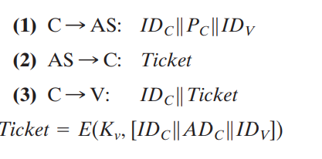
Kerberos Version 4
Makes use of DES to provide the authentication service
Authentication server (AS)
Knows the passwords of all users and stores these in a centralized database
Shares a unique secret key with each server
Ticket
Created once the AS accepts the user as authentic; contains the user’s ID and network address and the server’s ID
Encrypted using the secret key shared by the AS and the server
Ticket-granting server (TGS)
Issues tickets to users who have been authenticated to AS
Each time the user requires access to a new service the client applies to the TGS using the ticket to authenticate itself
The TGS then grants a ticket for the particular service
The client saves each service-granting ticket and uses it to authenticate its user to a server each time a particular service is requested
Notes:
Version 4 of Kerberos makes use of DES, in a rather elaborate protocol, to provide
the authentication service. Viewing the protocol as a whole, it is difficult to see the
need for the many elements contained therein. Therefore, we adopt a strategy used
by Bill Bryant of Project Athena [BRYA88] and build up to the full protocol by looking
first at several hypothetical dialogues. Each successive dialogue adds additional
complexity to counter security vulnerabilities revealed in the preceding dialogue.
In an unprotected network environment, any
client can apply to any server for service. The obvious security risk is that of impersonation.
An opponent can pretend to be another client and obtain unauthorized
privileges on server machines. To counter this threat, servers must be able to
confirm the identities of clients who request service. Each server can be required to
undertake this task for each client/server interaction, but in an open environment,
this places a substantial burden on each server.
An alternative is to use an authentication server (AS) that knows the passwords
of all users and stores these in a centralized database. In addition, the AS
shares a unique secret key with each server. These keys have been distributed physically
or in some other secure manner.
The AS checks its database to see if the user has supplied the proper
password for this user ID and whether this user is permitted access to server V. If
both tests are passed, the AS accepts the user as authentic and must now convince
the server that this user is authentic. To do so, the AS creates a ticket that contains
the user’s ID and network address and the server’s ID. This ticket is encrypted
using the secret key shared by the AS and this server.
TGS, issues tickets to users who have been authenticated to
AS. Thus, the user first requests a ticket-granting ticket from the AS. The
client module in the user workstation saves this ticket. Each time the user requires
access to a new service, the client applies to the TGS, using the ticket to authenticate
itself. The TGS then grants a ticket for the particular service. The client saves
each service-granting ticket and uses it to authenticate its user to a server each time
a particular service is requested.
Because only the correct user should know the password, only the correct user
can recover the ticket. Thus, we have used the password to obtain credentials from
Kerberos without having to transmit the password in plaintext. The ticket itself
consists of the ID and network address of the user, and the ID of the TGS. This
corresponds to the first scenario. The idea is that the client can use this ticket to
request multiple service-granting tickets. So the ticket-granting ticket is to be reusable.
However, we do not wish an opponent to be able to capture the ticket and
use it. Consider the following scenario: An opponent captures the login ticket and
waits until the user has logged off his or her workstation. Then the opponent either
gains access to that workstation or configures his workstation with the same network
address as that of the victim. The opponent would be able to reuse the ticket
to spoof the TGS. To counter this, the ticket includes a timestamp, indicating the
date and time at which the ticket was issued, and a lifetime, indicating the length
of time for which the ticket is valid (e.g., eight hours). Thus, the client now has a
reusable ticket and need not bother the user for a password for each new service
request. Finally, note that the ticket-granting ticket is encrypted with a secret key
known only to the AS and the TGS. This prevents alteration of the ticket. The ticket
is reencrypted with a key based on the user’s password. This assures that the ticket
can be recovered only by the correct user, providing the authentication.
The service-granting ticket has the same structure as the ticket-granting ticket.
Indeed, because the TGS is a server, we would expect that the same elements are
needed to authenticate a client to the TGS and to authenticate a client to an application
server. Again, the ticket contains a timestamp and lifetime. If the user wants
access to the same service at a later time, the client can simply use the previously
acquired service-granting ticket and need not bother the user for a password. Note
that the ticket is encrypted with a secret key known only to the TGS and the
server, preventing alteration.

Slide 38
The Version 4 Authentication Dialogue
The lifetime associated with the ticket-granting ticket creates a problem:
If the lifetime is very short (e.g., minutes), the user will be repeatedly asked for a password
If the lifetime is long (e.g., hours), then an opponent has a greater opportunity for replay
A network service (the TGS or an application service) must be able to prove that the person using a ticket is the same person to whom that ticket was issued
Servers need to authenticate themselves to users
Notes:
The heart of the first problem is the lifetime associated with the ticket-granting ticket.
If this lifetime is very short (e.g., minutes), then the user will be repeatedly asked
for a password. If the lifetime is long (e.g., hours), then an opponent has a greater
opportunity for replay. An opponent could eavesdrop on the network and capture
a copy of the ticket-granting ticket and then wait for the legitimate user to log out.
Then the opponent could forge the legitimate user’s network address and send the
message of step (3) to the TGS. This would give the opponent unlimited access to
the resources and files available to the legitimate user.
Similarly, if an opponent captures a service-granting ticket and uses it before it
expires, the opponent has access to the corresponding service.
Thus, we arrive at an additional requirement. A network service (the TGS or
an application service) must be able to prove that the person using a ticket is the
same person to whom that ticket was issued.
The second problem is that there may be a requirement for servers to
authenticate themselves to users. Without such authentication, an opponent could
sabotage the configuration so that messages to a server were directed to another
location. The false server would then be in a position to act as a real server and
capture any information from the user and deny the true service to the user.

Slide 39
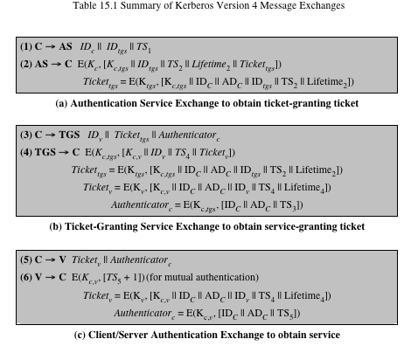
Table 15.1 (page 464 in textbook)
Summary of Kerberos Version 4 Message Exchanges
Notes:
Table 15.1, shows the actual Kerberos protocol.
Table 15.1a shows the technique for distributing the session key. As before,
the client sends a message to the AS requesting access to the TGS. The AS responds
with a message, encrypted with a key derived from the user’s password that
contains the ticket. The encrypted message also contains a copy of the session key,
where the subscripts indicate that this is a session key for C and TGS. Because
this session key is inside the message encrypted with K_{c} , only the user’s client can
read it. The same session key is included in the ticket, which can be read only by
the TGS. Thus, the session key has been securely delivered to both C and the TGS.
Armed with the ticket and the session key, C is ready to approach the TGS.
As before, C sends the TGS a message that includes the ticket plus the ID of the requested
service [message (3) in Table 15.1b].
The reply from the TGS in message (4) follows the form of message (2). The
message is encrypted with the session key shared by the TGS and C and includes
a session key to be shared between C and the server V, the ID of V, and the timestamp
of the ticket. The ticket itself includes the same session key.
C now has a reusable service-granting ticket for V. When C presents this ticket,
as shown in message (5), it also sends an authenticator. The server can decrypt the
ticket, recover the session key, and decrypt the authenticator.
If mutual authentication is required, the server can reply as shown in message
(6) of Table 15.1. The server returns the value of the timestamp from the authenticator,
incremented by 1, and encrypted in the session key. C can decrypt this message
to recover the incremented timestamp. Because the message was encrypted by
the session key, C is assured that it could have been created only by V. The contents
of the message assure C that this is not a replay of an old reply.
Finally, at the conclusion of this process, the client and server share a secret
key. This key can be used to encrypt future messages between the two or to exchange
a new random session key for that purpose.

Slide 40
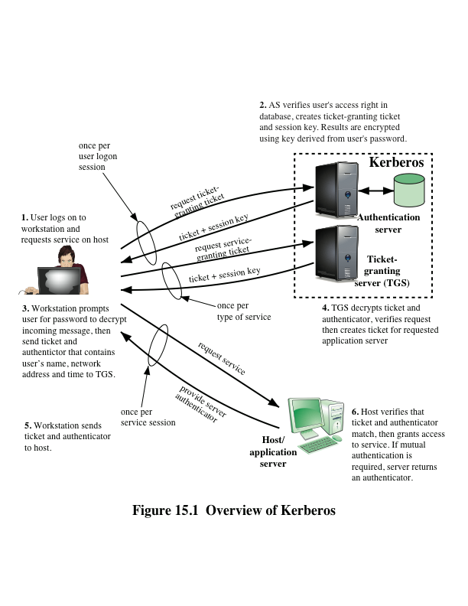
Notes:
Figure 15.1 provides an overview.
First, consider the problem of captured ticket-granting tickets and the need
to determine that the ticket presenter is the same as the client for whom the ticket
was issued. The threat is that an opponent will steal the ticket and use it before it
expires. To get around this problem, let us have the AS provide both the client and
the TGS with a secret piece of information in a secure manner. Then the client can
prove its identity to the TGS by revealing the secret information—again in a secure
manner. An efficient way of accomplishing this is to use an encryption key as the
secure information; this is referred to as a session key in Kerberos.

Slide 41
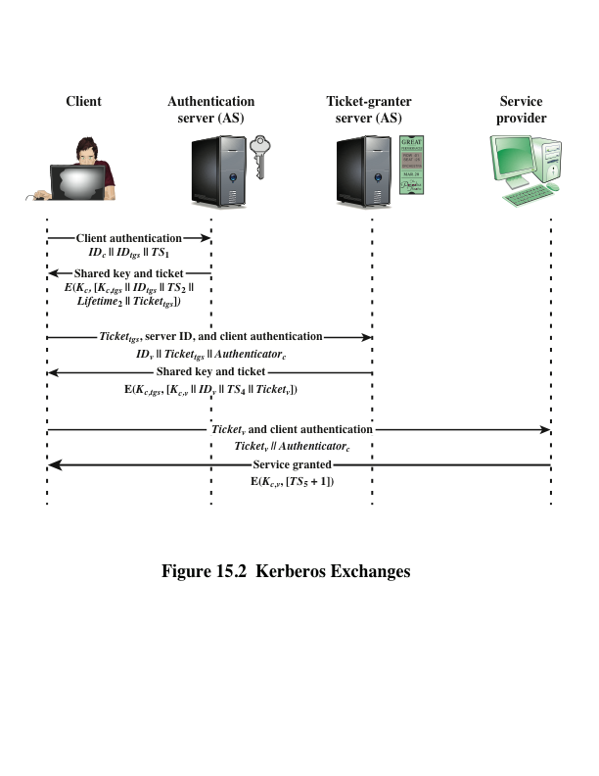
Notes:
Figure 15.2 illustrates the Kerberos exchanges among the parties.

Slide 42
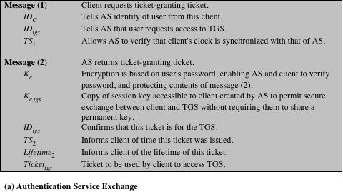
(This table can be found on pages 467 – 468 in the textbook)
Notes:
Table 15.2
summarizes the justification for each of the elements in the Kerberos protocol.
Page 1 – authentication service exchange

Slide 43
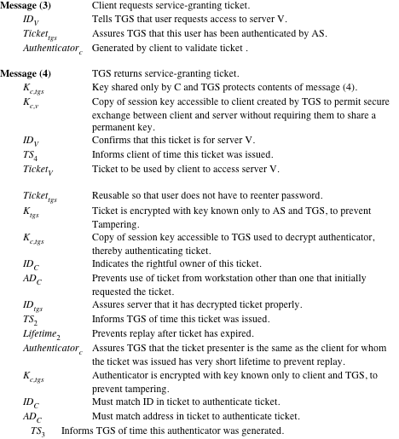
Notes:
Page 2 – ticket-granting service exchange

Slide 44
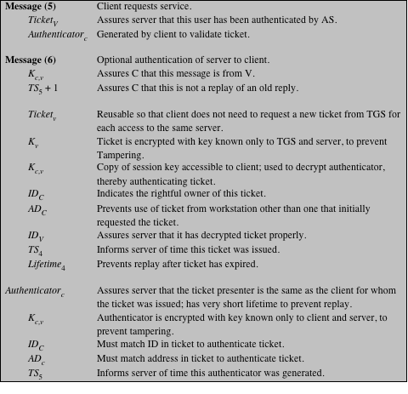
(page 3 of 3)
Notes:
Page 3 – client/server authentication exchange

Slide 45
Kerberos Realms and Multiple Kerberi
A full-service Kerberos environment consisting of a Kerberos server, a number of clients, and a number of application servers requires that:
The Kerberos server must have the user ID and hashed passwords of all participating users in its database; all users are registered with the Kerberos server
The Kerberos server must share a secret key with each server; all servers are registered with the Kerberos server
The Kerberos server in each interoperating realm shares a secret key with the server in the other realm; the two Kerberos servers are registered with each other
Notes:
A full-service Kerberos environment
consisting of a Kerberos server, a number of clients, and a number of application
servers requires the following:
1. The Kerberos server must have the user ID and hashed passwords of all participating
users in its database. All users are registered with the Kerberos server.
2. The Kerberos server must share a secret key with each server. All servers are
registered with the Kerberos server.
Networks of clients and servers under different administrative organizations
typically constitute different realms. That is, it generally is not practical or does not
conform to administrative policy to have users and servers in one administrative
domain registered with a Kerberos server elsewhere. However, users in one realm
may need access to servers in other realms, and some servers may be willing to provide
service to users from other realms, provided that those users are authenticated.
Kerberos provides a mechanism for supporting such interrealm authentication.
For two realms to support interrealm authentication, a third requirement is added:
3. The Kerberos server in each interoperating realm shares a secret key with the
server in the other realm. The two Kerberos servers are registered with each other.
The scheme requires that the Kerberos server in one realm trust the Kerberos
server in the other realm to authenticate its users. Furthermore, the participating
servers in the second realm must also be willing to trust the Kerberos server in the
first realm.

Slide 46
Kerberos Realm
A set of managed nodes that share the same Kerberos database
The database resides on the Kerberos master computer system, which should be kept in a physically secure room
A read-only copy of the Kerberos database might also reside on other Kerberos computer systems
All changes to the database must be made on the master computer system
Changing or accessing the contents of a Kerberos database requires the Kerberos master password
Notes:
A Kerberos realm is a set of managed nodes that
share the same Kerberos database. The Kerberos database resides on the Kerberos
master
computer system, which should be kept in a physically secure room. A read-only
copy of the Kerberos database might also reside on other Kerberos computer
systems. However, all changes to the database must be made on the master computer
system. Changing or accessing the contents of a Kerberos database requires
the Kerberos master password.

Slide 47
Kerberos Principal
Three parts of a principal name
A service or user name
An instance name
A realm name
A service or user that is known to the Kerberos system
Identified by its principal name
Notes:
A related concept is that of a Kerberos principal ,
which is a service or user that is known to the Kerberos system. Each Kerberos
principal is identified by its principal name. Principal names consist of three parts: a
service or user name, an instance name, and a realm name.

Slide 48
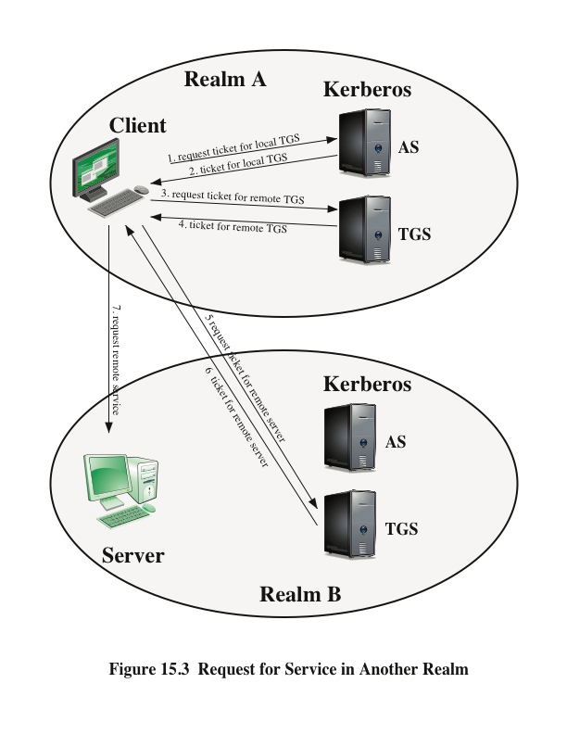
Notes:
With these ground rules in place, we can describe the mechanism as follows
(Figure 15.3): A user wishing service on a server in another realm needs a ticket for
that server. The user’s client follows the usual procedures to gain access to the local
TGS and then requests a ticket-granting ticket for a remote TGS (TGS in another
realm). The client can then apply to the remote TGS for a service-granting ticket for
the desired server in the realm of the remote TGS.

Slide 49
Differences Between Versions 4 and 5
Version 5 is intended to address the limitations of version 4 in two areas:
Environmental shortcomings
Encryption system dependence
Internet protocol dependence
Message byte ordering
Ticket lifetime
Authentication forwarding
Interrealm authentication
Technical deficiencies
Double encryption
PCBC encryption
Session keys
Password attacks
Notes:
Version 5 is intended to address the limitations
of version 4 in two areas: environmental shortcomings and technical deficiencies.
Let us briefly summarize the improvements in each area.
Kerberos version 4 was developed for use within the Project Athena environment
and, accordingly, did not fully address the need to be of general purpose. This
led to the following environmental shortcomings .
1. Encryption system dependence: Version 4 requires the use of DES. Export
restriction on DES as well as doubts about the strength of DES were thus of
concern. In version 5, ciphertext is tagged with an encryption-type identifier so
that any encryption technique may be used. Encryption keys are tagged with a
type and a length, allowing the same key to be used in different algorithms and
allowing the specification of different variations on a given algorithm.
2. Internet protocol dependence: Version 4 requires the use of Internet Protocol
(IP) addresses. Other address types, such as the ISO network address, are not
accommodated. Version 5 network addresses are tagged with type and length,
allowing any network address type to be used.
3. Message byte ordering: In version 4, the sender of a message employs a byte
ordering of its own choosing and tags the message to indicate least significant
byte in lowest address or most significant byte in lowest address. This techniques
works but does not follow established conventions. In version 5, all message
structures are defined using Abstract Syntax Notation One (ASN.1) and
Basic Encoding Rules (BER), which provide an unambiguous byte ordering.
4. Ticket lifetime: Lifetime values in version 4 are encoded in an 8-bit quantity
in units of five minutes. Thus, the maximum lifetime that can be expressed is
2⁸ * 5 = 1280 minutes (a little over 21 hours). This may be inadequate for
some applications (e.g., a long-running simulation that requires valid Kerberos
credentials throughout execution). In version 5, tickets include an explicit start
time and end time, allowing tickets with arbitrary lifetimes.
5. Authentication forwarding: Version 4 does not allow credentials issued to one
client to be forwarded to some other host and used by some other client. This
capability would enable a client to access a server and have that server access
another server on behalf of the client. For example, a client issues a request to
a print server that then accesses the client’s file from a file server, using the client’s
credentials for access. Version 5 provides this capability.
6. Interrealm authentication: In version 4, interoperability among N realms
requires on the order of N² Kerberos-to-Kerberos relationships, as described
earlier. Version 5 supports a method that requires fewer relationships, as
described shortly.
Apart from these environmental limitations, there are technical deficiencies
in the version 4 protocol itself. Most of these deficiencies were documented in
[BELL90], and version 5 attempts to address these. The deficiencies are the following.
1. Double encryption: Note in Table 15.1 [messages (2) and (4)] that tickets provided
to clients are encrypted twice—once with the secret key of the target
server and then again with a secret key known to the client. The second encryption
is not necessary and is computationally wasteful.
2. PCBC encryption: Encryption in version 4 makes use of a nonstandard mode of
DES known as propagating cipher block chaining (PCBC). It has been demonstrated
that this mode is vulnerable to an attack involving the interchange of ciphertext
blocks [KOHL89]. PCBC was intended to provide an integrity check as
part of the encryption operation. Version 5 provides explicit integrity mechanisms,
allowing the standard CBC mode to be used for encryption. In particular, a checksum
or hash code is attached to the message prior to encryption using CBC.
3. Session keys: Each ticket includes a session key that is used by the client to
encrypt the authenticator sent to the service associated with that ticket. In addition,
the session key may subsequently be used by the client and the server
to protect messages passed during that session. However, because the same
ticket may be used repeatedly to gain service from a particular server, there is
the risk that an opponent will replay messages from an old session to the client
or the server. In version 5, it is possible for a client and server to negotiate a
subsession key, which is to be used only for that one connection. A new access
by the client would result in the use of a new subsession key.
4. Password attacks: Both versions are vulnerable to a password attack. The message
from the AS to the client includes material encrypted with a key based
on the client’s password.10 An opponent can capture this message and attempt
to decrypt it by trying various passwords. If the result of a test decryption is
of the proper form, then the opponent has discovered the client’s password
and may subsequently use it to gain authentication credentials from Kerberos.
This is the same type of password attack described in Chapter 21, with the
same kinds of countermeasures being applicable. Version 5 does provide a
mechanism known as pre-authentication, which should make password attacks
more difficult, but it does not prevent them.

Slide 50
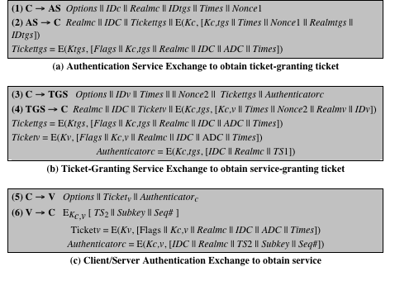
Table 15.3
Summary of Kerberos Version 5 Message Exchanges
Notes:
Table 15.3 summarizes the basic version
5 dialogue. This is best explained by comparison with version 4 (Table 15.1).

Slide 51
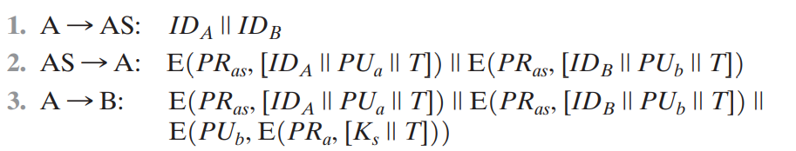
Mutual Authentication
Public-key encryption for session key distribution
Assumes each of the two parties is in possession of the current public key of the other
May not be practical to require this assumption
Denning protocol using timestamps
Uses an authentication server (AS) to provide public-key certificates
Requires the synchronization of clocks
Woo and Lam makes use of nonces
Care needed to ensure no protocol flaws
Notes:
In Chapter 14, we presented one approach to the use of public-key encryption for
the purpose of session-key distribution (Figure 14.9). This protocol assumes that
each of the two parties is in possession of the current public key of the other. It may
not be practical to require this assumption.
A protocol using timestamps is provided in [DENN81]
In this case, the central system is referred to as an authentication server (AS),
because it is not actually responsible for secret-key distribution. Rather, the AS provides
public-key certificates. The session key is chosen and encrypted by A; hence,
there is no risk of exposure by the AS. The timestamps protect against replays of
compromised keys.
This protocol is compact but, as before, requires the synchronization of clocks.
Another approach, proposed by Woo and Lam [WOO92a], makes use of nonces.
This seems to be a secure protocol that takes into account the various attacks.
However, the authors themselves spotted a flaw and submitted a revised version of
the algorithm.
In both this example and the protocols described earlier, protocols that appeared
secure were revised after additional analysis. These examples highlight the
difficulty of getting things right in the area of authentication.

Slide 52
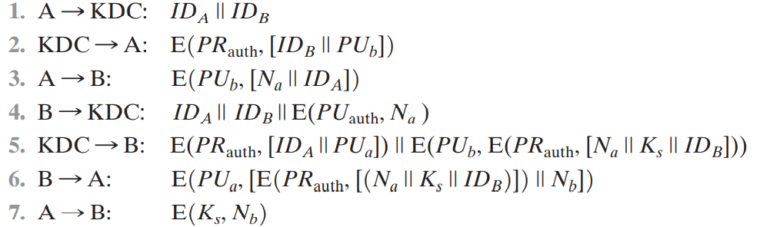
Mutual Authentication
Notes:
In Chapter 14, we presented one approach to the use of public-key encryption for
the purpose of session-key distribution (Figure 14.9). This protocol assumes that
each of the two parties is in possession of the current public key of the other. It may
not be practical to require this assumption.
A protocol using timestamps is provided in [DENN81]
In this case, the central system is referred to as an authentication server (AS),
because it is not actually responsible for secret-key distribution. Rather, the AS provides
public-key certificates. The session key is chosen and encrypted by A; hence,
there is no risk of exposure by the AS. The timestamps protect against replays of
compromised keys.
This protocol is compact but, as before, requires the synchronization of clocks.
Another approach, proposed by Woo and Lam [WOO92a], makes use of nonces.
This seems to be a secure protocol that takes into account the various attacks.
However, the authors themselves spotted a flaw and submitted a revised version of
the algorithm.
In both this example and the protocols described earlier, protocols that appeared
secure were revised after additional analysis. These examples highlight the
difficulty of getting things right in the area of authentication.

Slide 53
One-Way Authentication
Have public-key approaches for e-mail
Encryption of message for confidentiality, authentication, or both
The public-key algorithm must be applied once or twice to what may be a long message
For confidentiality encrypt message with one-time secret key, public-key encrypted
If authentication is the primary concern, a digital signature may suffice
Notes:
We have already presented public-key encryption approaches that are suited to electronic mail, including the straightforward encryption of the entire message for confidentiality (Figure 12.1b), authentication (Figure 12.1c), or both (Figure 12.1d). These approaches require that either the sender know the recipient's public key (confidentiality) or the recipient know the sender's public key (authentication) or both (confidentiality plus authentication). In addition, the public-key algorithm must be applied once or twice to what may be a long message.
If confidentiality is the primary concern, then better to encrypt the message with a one-time secret key, and also encrypt this one-time key with B's public key. If authentication is the primary concern, then a digital signature may suffice (but could be replaced by an opponent). To counter such a scheme, both the message and signature can be encrypted with the recipient's public key. The latter two schemes require that B know A's public key and be convinced that it is timely. An effective way to provide this assurance is the digital certificate.
If authentication is the primary concern, then a digital signature may suffice.

Slide 54


Slide 55
The End

